Slide 1
Project 4
C A F E
A N A L Y S I S
MATTHEW KASIMAN, MICHELLE LIE, KRISTI KANADI, ABHAY KOTHARI, NICO SANTOSO

Slide 2
01
Business Goal
Identifying factors that affect total sales through Multivariate Linear Regression and predicting order profiles of each coffee store branch

Slide 3
02
Dependent Variable
MLR: Total Bill
NNM: Store ID

Slide 4
03
Dataset
Coffee Shop Sales Analysis - Kaggle

Slide 5
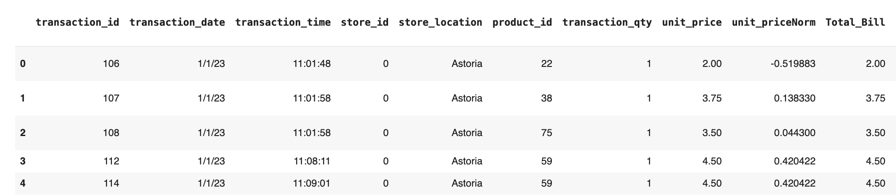
D
A
T
A
S
E
T
O
V
E
R
V
I
E
W
KAGGLE LINK:
https://www.kaggle.com/datasets/divu2001/coffee-shop-sales-analysis
Our Dataset
Time series data of order transaction details that include item ordered, quantity ordered, total bill, and store location.
There are 3 store locations - Astoria, Hell’s Kitchen, and Lower Manhattan
6 months worth of transactions in 2023.
We calculated the time in between orders for both our regression and neural network model.
We normalized variables for our neural network creating unitpriceNorm, totalbillNorm, and timeNorm.

Slide 6
04
Multivariate Linear Regression

Slide 7
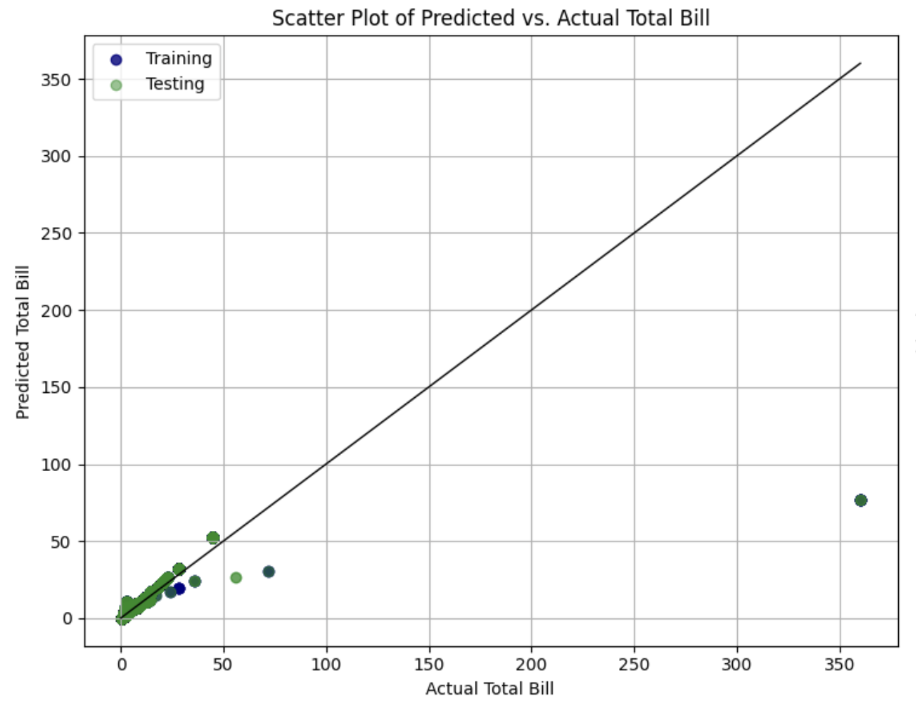
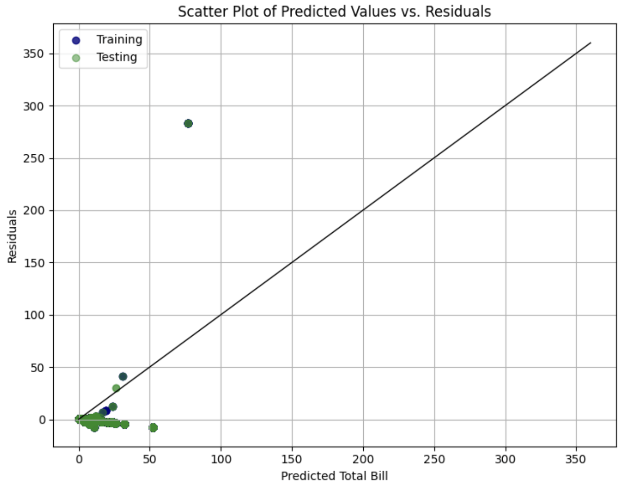
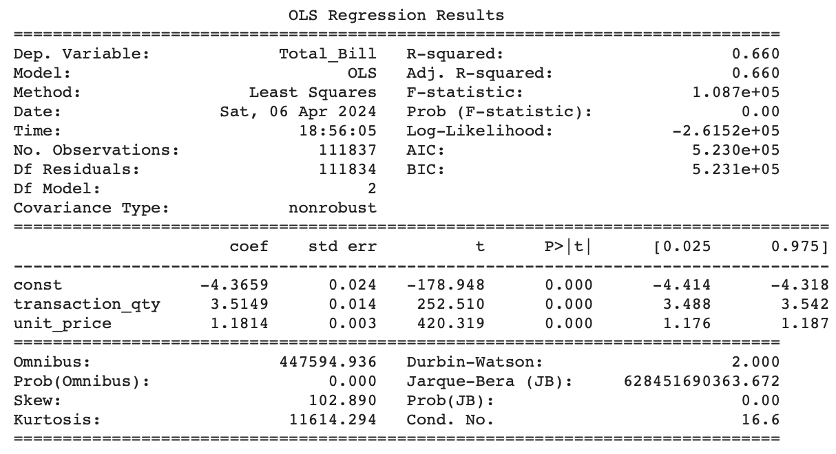
Initial Model
We elected to only include the transaction quantity and unit price in our initial model as we believed that it would be the strongest indicator of revenue generated from each transaction.
The R-squared provided by the model fitted on the training dataset is 66%
Upon closer examination of the coefficient values, it becomes evident that transaction quantity exerts the most substantial influence on the total bill. For every additional unit increase in transaction quantity, we observe an approximate $3.51 rise in the total bill. Similarly, for each unit increase in the unit price, we notice a corresponding increase of approximately $1.18 in the total bill.
We also calculated R-squared data based on the testing dataset and noted a score of 69.18% which indicates that the initial model explains at least 66% of the variance.

Slide 8
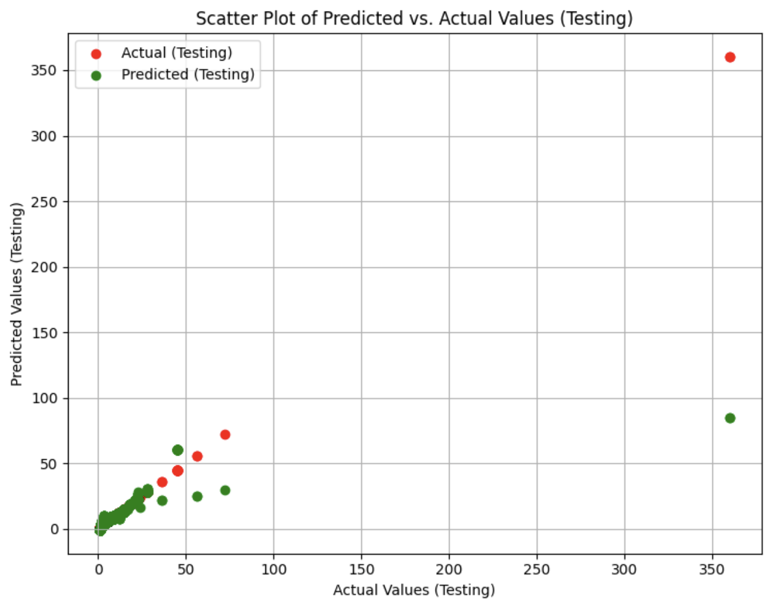
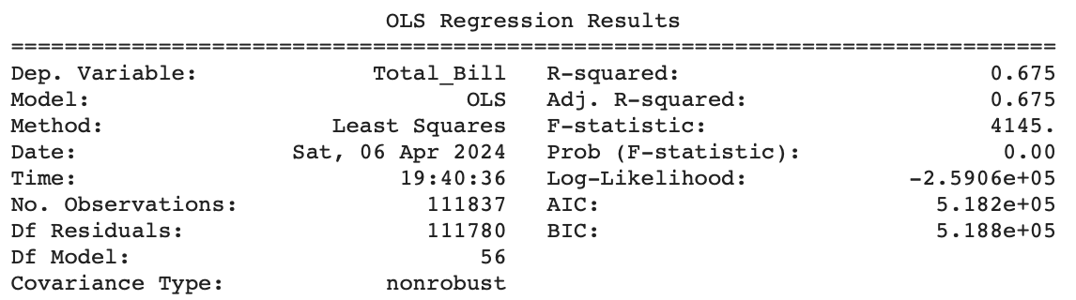
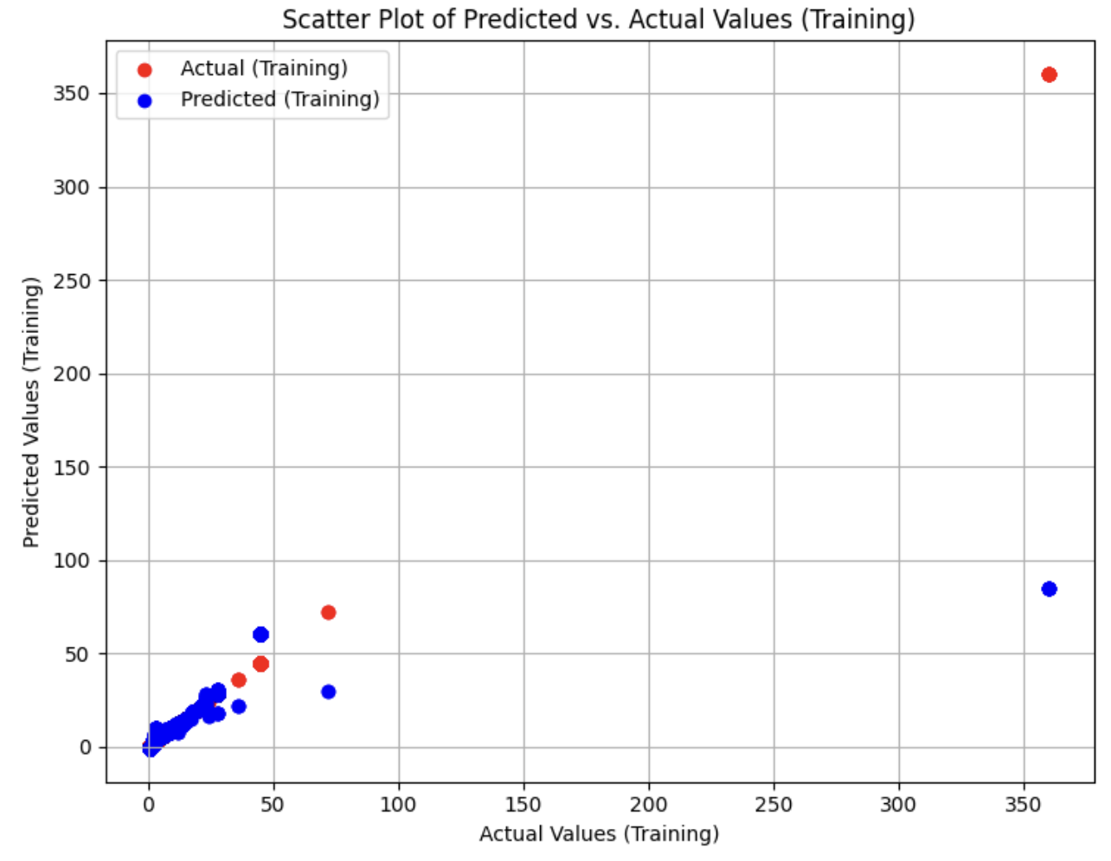
Revised Model
We encoded dummy variables for the product category, type and detail to examine if the product itself be significant in explaining the total revenue generated per each transaction.
The R-squared provided by the model fitted on the training dataset is 67.5% and the R-squared data based on the testing dataset and noted a score of 70.57% which indicates that the initial model explains at least 66% of the variance.
When taking a closer look at the coefficients of the variables involved, we note that transaction quantity has the greatest impact of total Bill as each additional unit increase in transaction_qty, the total bill is expected to increase by approximately $3.50, holding other variables constant which is similar to the initial model
We had also attempted to encode in interaction terms for product category and size to see if there is a relationship between said product category and the order size. We noted that the R-squared of the training dataset and the test dataset remained unchanged. Furthermore, we note that most of the variables included in the dataset were insignificant.

Slide 9
05
Neural Network Model

Slide 10
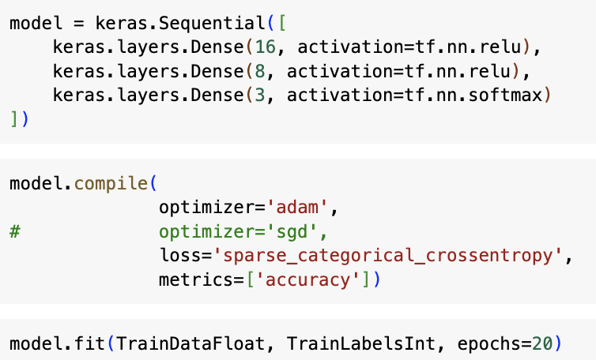
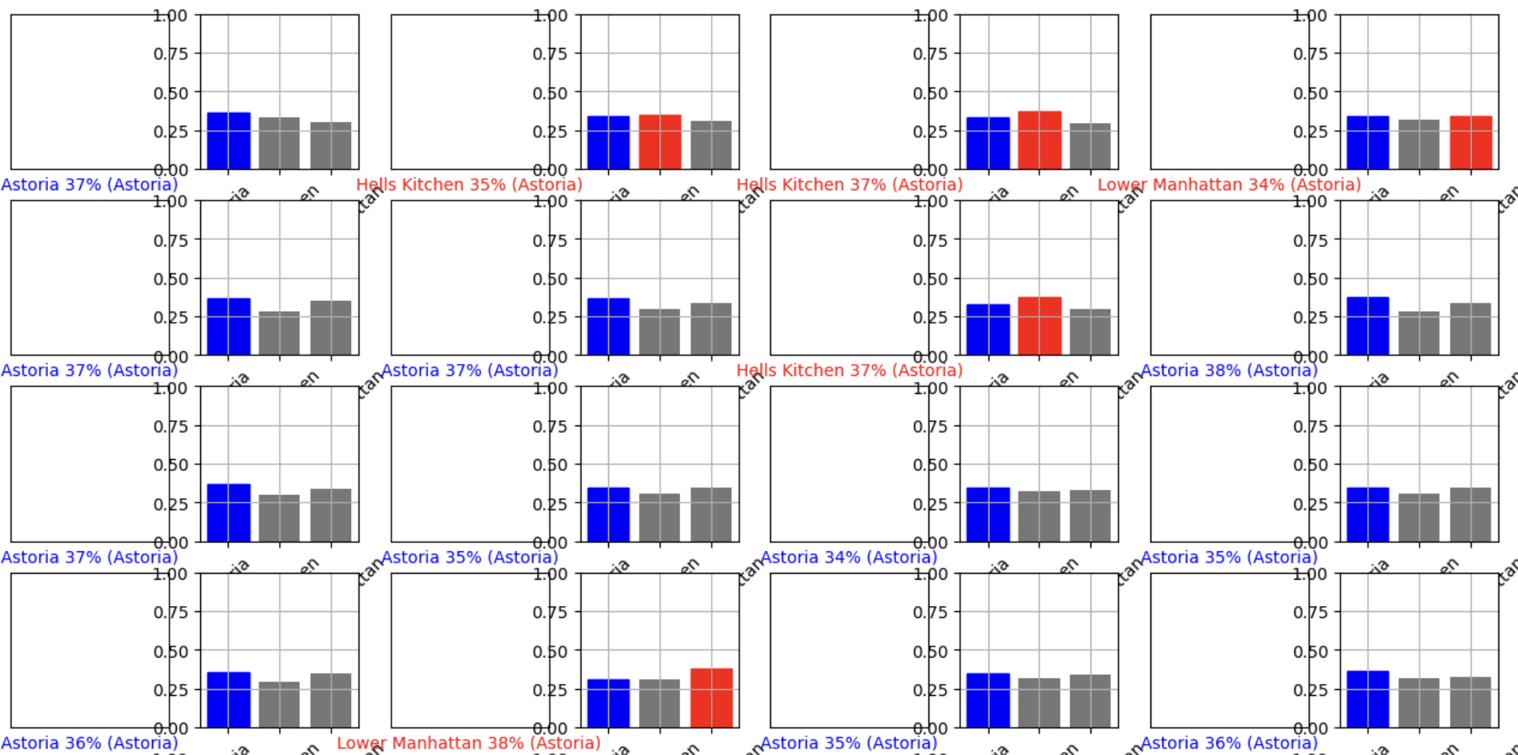
Neural Network Model
We ran our neural network model with 3 layers, 20 epochs, and achieved an accuracy of only 38.14%. Initially believing that each store will have it’s own popular item, or an order profile, that could help us distinguish between one store to another.
Given our low accuracy, the model is unable to predict each store based on the variables we have selected. Based on our qualitative research, Hell’s Kitchen had the highest income per capita, hypothesizing that people would spend more on locations with a higher income consumer base.
We decided to add another layer and ran the model with 100 epochs and yet it yielded the same accuracy.
Our results prove that our hypothesis needs to be refined or we should reconsider the variables we are training our model on. We can ultimately conclude that each store’s order profile are quite similar and that there is no distinct classifier that can distinguish each store from one another.

Slide 11
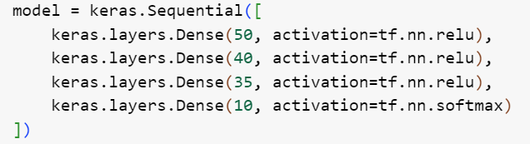
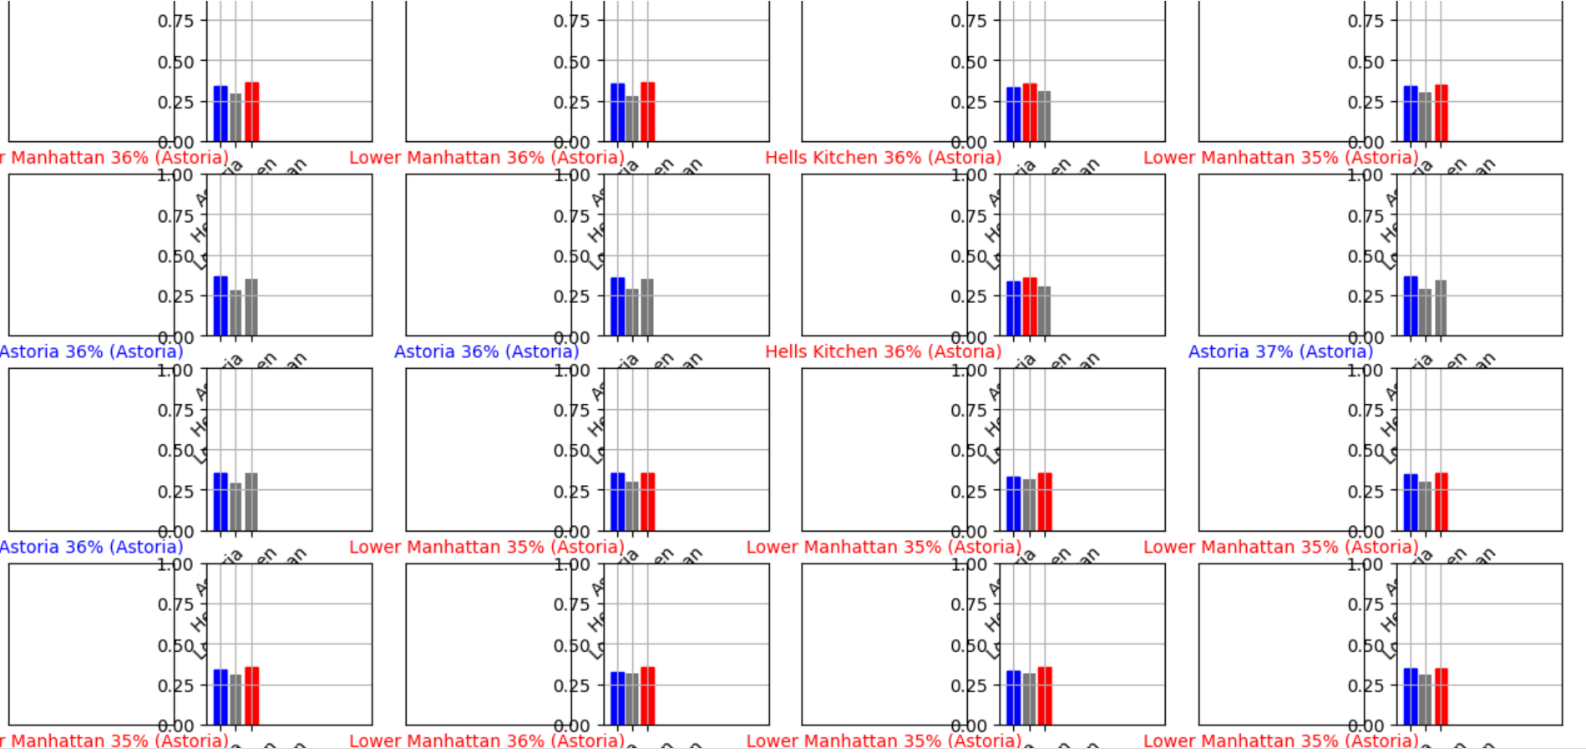
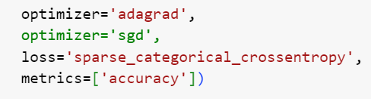
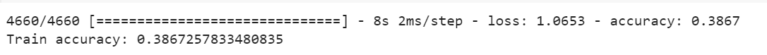
Improved Neural Network Model
Looking to improve our model’s accuracy, we reran our neural network model with 4 layers, 25 epochs, and achieved an accuracy of only 38.67%. We achieved an increase in accuracy by 0.53%.
Since increasing the number of epochs for the original model did not make a difference, we added another layer and increased the number of nodes in each layer with 50, 40, 35 and 10 nodes respectively. This helps increase model complexity to better understand the complexity of the data.
We did not change the original loss function of ‘sparse_categorical_crossentropy’ because it works best with our data that has multi-class classification (store location) with integer target labels. However, we changed the optimizer to ‘adagrad’ that yields better accuracy for the model.
In our initial model, we have added more independent variables to the initial data that would be beneficial for our model. Since we are still not able to improve the accuracy of the model by more than 0.53%, model is still unable to predict each store based on the variables we have selected and our conclusion remains the same.

Slide 12
06
Conclusions
1) Transaction Quantity is a Strong Predictor: Our Initial Linear Regression model and Revised model suggests that transaction quantity is a significant predictor of revenue generated from each transaction. The high coefficient value and its impact on the total bill highlight its importance in predicting revenue.
3) Hypothesis Refinement: Our findings indicate the necessity of refining our hypothesis or reassessing the variables used in our model training. Ultimately, we can conclude that the order profiles of each store are notably similar, leading to the absence of a distinct classifier capable of distinguishing between stores.
2) Model Performance and Generalization: Both models demonstrate a good level of performance as indicated by the R-squared values on the training dataset and the testing dataset. This suggests that the model generalizes well beyond the training data, capturing a considerable portion of the variance in the total bill. Further refinement through inclusion of additional variables may enhance the model's predictive accuracy and explanatory power.

